Slide 1


Slide 2

The State of Azure Infrastructure as Code
Sam Cogan
Solution Architect, Willis Towers Watson & Microsoft MVP

Slide 3


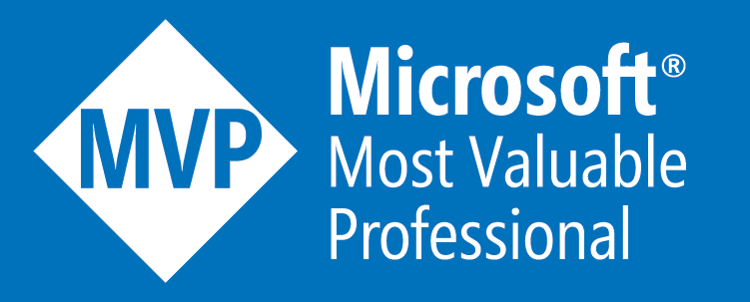


About Me
Sam Cogan
Solution Architect – Willis Towers Watson
Microsoft Azure MVP
samcogan.com
@samcogan
sam-cogan

Slide 4
What is Infrastructure as Code?
Declarative
Correct Drift
Idempotent
Modular
Immutable
Reusable

Slide 5
Benefits
Consistency
1
Speed
2
Collaboration
3
Accountability
4
Scalability
5
Versioning
6
Testing
7
Documentation
8

Slide 6
Benefits
Consistency
Speed
Versioning
Accountability & Change Management
Scalability
Testing
Documentation
Collaboration
Notes:
FunctionExamples.json – UniqueString, ResourceGroup, ListKeys, toLower
SaSToken.json – generating a SAS token with ListKeys
Mod.json – using mod to alternate between storage accounts

Slide 7





The Options in 2021
ARM Templates
Bicep
Terraform
Pulumi
PowerShell/CLI

Slide 8
Azure Resource Manager Templates
Microsoft native language for IaC on Azure
Supported directly by Microsoft
JSON based with a custom DSL
Stateless
Closed Source

Slide 9

Bicep
New Microsoft higher level abstraction for Iac on Azure
Supported directly by Microsoft
Custom DSL
Uses ARM templates under the hood
Stateless
Open Source

Slide 10

Terraform
Third party multi-platform IaC solution
Supported by Hashicorp or community
Probably the largest user base of all IaC tools
Custom DSL (HCL)
Stateful
Open Source
Enterprise version available

Slide 11
Pulumi
Third part multi-platform IaC solution
Support by Pulumi or community
Not a DSL, uses real languages such as Python, Go, TypeScript and .net
Stateful
Open Source
Enterprise version available

Slide 12

Farmer
Third party Azure only IaC solution
Supported by Compositional IT or community
DSL based on F# language
Compiles to ARM templates under the hood
Stateless
Open Source

Slide 13
CLI/PowerShell
Not really Infrastructure as Code
Not Idempotent
Not declarative
May have it’s place where all else fails
Consider using an escape hatch in your IaC language first

Slide 14
Which to Choose?

Slide 15
Multi-Platform Support

Slide 16
Microsoft Support & Updates

Slide 17
Programming Language Support

Slide 18
Stateful

Slide 19
Stateless

Slide 20
Comparison
 | ARM Templates | Bicep | Terraform | Pulumi | Farmer
Languages | JSON | Custom DSL | Custom DSL (HCL) | Node JS (TS, JS), Python, .NET Core, GO | F#
Speed Of Update | Fast | Fast | Slower | Slower | Slower
Multi Cloud | No | No | Yes | Yes | No
Stateful | No | No | Yes | Yes | No
Open Source | No | Yes | Yes | Yes | Yes
Support | Microsoft | Microsoft | Community/Paid | Community/Paid | Community/Paid
Additional Features | Policy (separate service) | Policy (separate service) | Cloud State Policy & Governance Module Repository Web Portal Cost Estimation | Cloud State Policy & Governance Web Portal

Slide 21
Changing Language
Are you unhappy with your current choice?
How much work is it to transition?
Can you transition gradually?
Does it add value?

Slide 22
Real World Scenarios
Getting started
Developer Adoption
End to End Kubernetes Deployment
Automation Platform
Escape Hatches

Slide 23
About Me
Sam Cogan
Solution Architect – Willis Towers Watson
Microsoft Azure MVP
samcogan.com
@samcogan
sam-cogan

